Slide 1
Part 2.9: Electronic Transitions

Slide 2
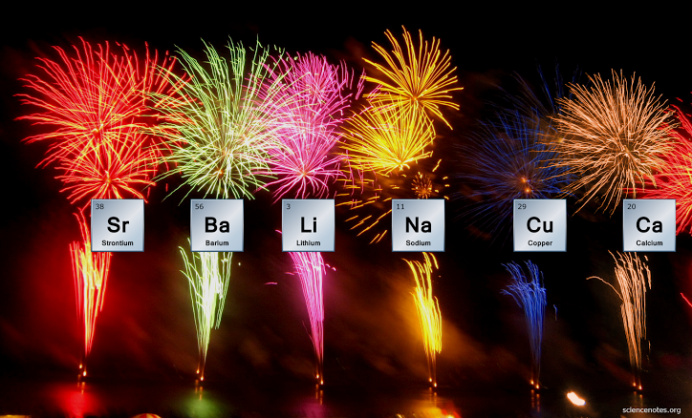
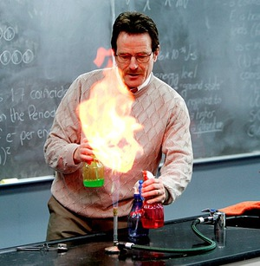
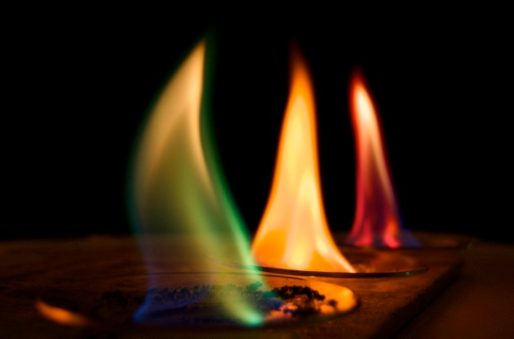
Outline
Absorption spectroscopy
Types of transitions
atomic
molecular
d-d transitions
Transition moment
Microstates
Correlation diagrams
Tanabe-Sugano diagrams
Selection rules

Slide 3
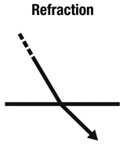
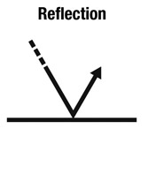
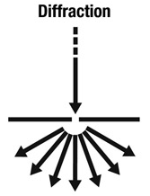
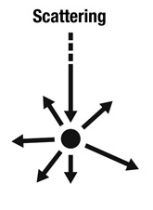
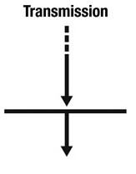
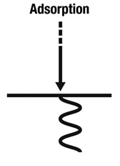
Interaction of Light with Matter
Rainbows
Glasses
Mirage
Refractometer
Moon Light
Butterfly Wings
Sea Shells
Soap Bubbles
Two-slit exp
Holograms
Shadow Blur
Sand in Water
Sunsets
Notes:
Reflection:
Pigmented Color vs structural color
structural color changes with angle
Refraction:
light travels at different speeds
Diffraction:
bending and spreading out of waves at small openings

Slide 4
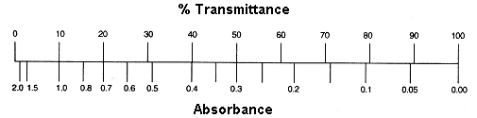
Absorption Spectrosocpy
hν
hν
Sample
We don’t measure absorbance. We measure transmittance.
Sample
Transmittance:
T = P/P₀
P₀
P
Absorbance:
A = -log T = log P₀/P
(power in)
(power out)

Slide 5
Beer’s Law
The Beer-Lambert Law (λ specific):
A = ε c l
Sample
A = absorbance (unitless, A = log₁₀ P₀/P)
ε = molar absorptivity (L mol⁻¹ cm⁻¹)
l = path length of the sample (cm)
c = concentration (mol/L or M)
P₀
P
(power in)
(power out)
l in cm
Concentration
Absorbance
Path length
Absorbance
Molar Abs.
Absorbance

Slide 6
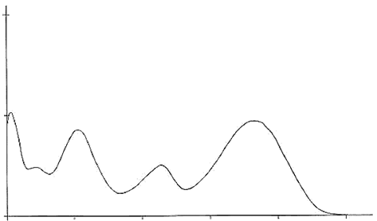
Beer’s Law
The Beer-Lambert Law (λ specific):
A = ε c l
Sample
A = absorbance (unitless, A = log₁₀ P₀/P)
ε = molar absorptivity (L mol⁻¹ cm⁻¹)
l = path length of the sample (cm)
c = concentration (mol/L or M)
P₀
P
(power in)
(power out)
l in cm
What are we actually measuring/observing?
ε
100
200
300
400
500
Wavelength (nm)

Slide 7
Electronic Transitions
Interaction between an electromagnetic wave and the wave function of a molecule/atom/material.
Transition between quantized energy states of an atom/molecule/material.
Exciting an electron from one quantum state to another.
hν
hν
Ground
State (S₀)
First Excited
State (S₁)

Slide 8
Electronic Transitions
Spectral Features:
Number of transitions.
Energy of the transitions.
Intensity of the transitions.
ε
100
200
300
400
500
Wavelength (nm)

Slide 9
Electronic Transitions
Spectral Features:
Number of transitions.
Energy of the transitions.
Intensity of the transitions.
hν
hν
ε
100
200
300
400
500
hν
Wavelength (nm)

Slide 10
Electronic Transitions
Spectral Features:
Number of transitions.
Energy of the transitions.
Intensity of the transitions.
Shape of the transition.
hν
ε
100
200
300
400
500
Transition Probability
ΔE
Wavelength (nm)

Slide 11
Atomic Transition
hν
Energy
hν
Ground State
Excited State
Notes:
does an orbital exist if there is no electron in it
Follows Aufbau Principle

Slide 12
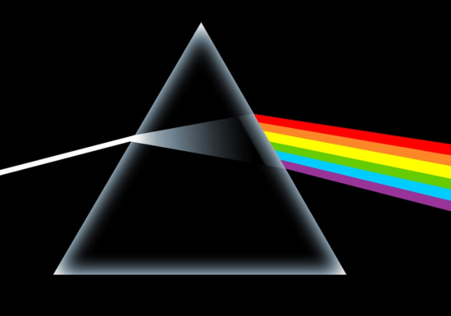
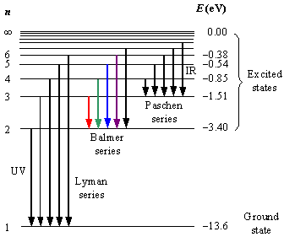
Hydrogen Absorption
H
H
H
H
H
H
H
white light source
Hydrogen Sample
Prism
Line Spectrum
Rydberg Formula
Notes:
rydberg constant
prism dependent on the wavelength and the angle of refraction

Slide 13
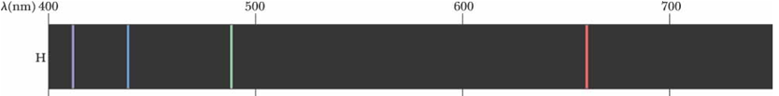
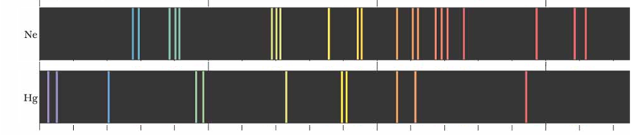
Increasing Complexity
1 e⁻
10 e⁻
80 e⁻
Atomic Transitions
(movement of electrons)
+
Molecular Transitions
(movement of electron density)
250 e⁻

Slide 14
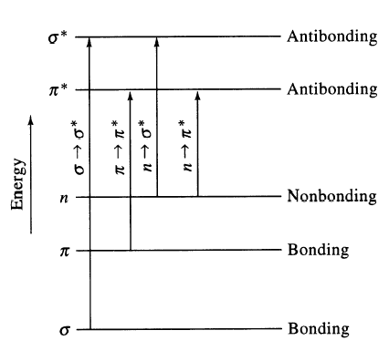
Types of Molecular Transitions
σ - σ*
λ_{max} < 150 nm
π - π*
λ_{max} 200 - 800 nm
σ - σ*
π - π*
Absorption
n - π*
λ_{max} 150 - 300 nm
n - π*
100
200
300
400
500
Wavelength (nm)

Slide 15
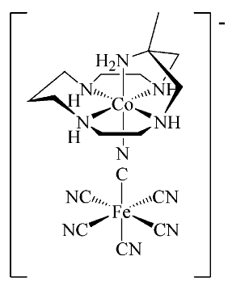
Types of Molecular Transitions
Focus on Metal Centered Transitions
[Co(H₂O)₆]²⁺
Metal Centered (MC)
λ_{max} 200 –800 nm
MnO₄⁻
MLCT
λ_{max} 300 –1000 nm
LMCT
λ_{max} 300 –1000 nm
MMCT
λ_{max} 300 –800 nm

Slide 16
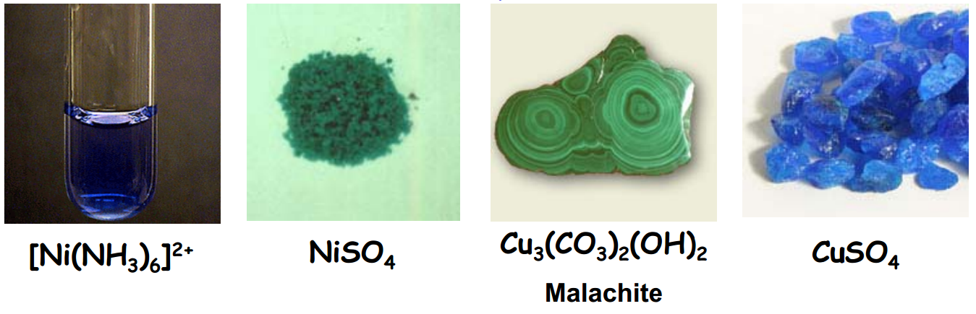
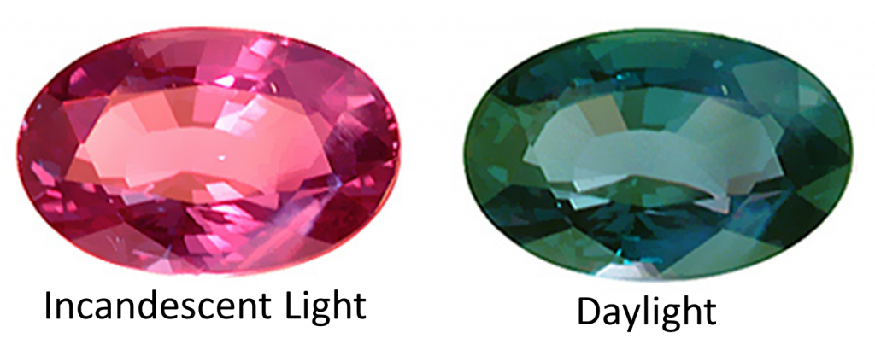
Colors of Metal Ions
Alexandrite
Cr³⁺ doped
BeAl₂O₄

Slide 17
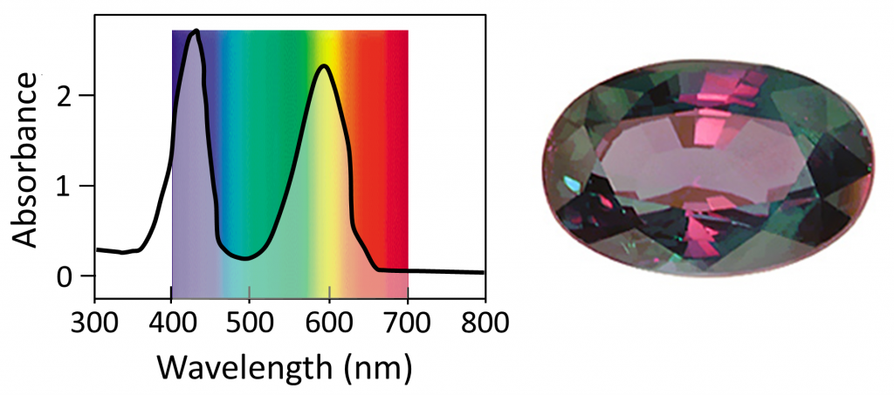
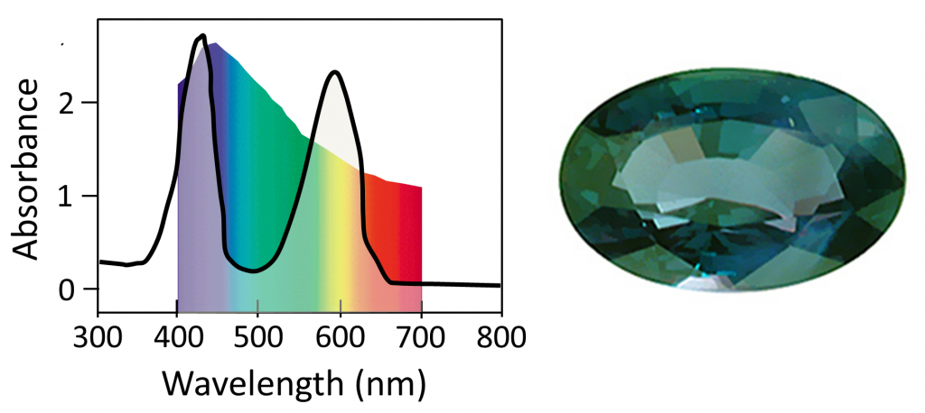
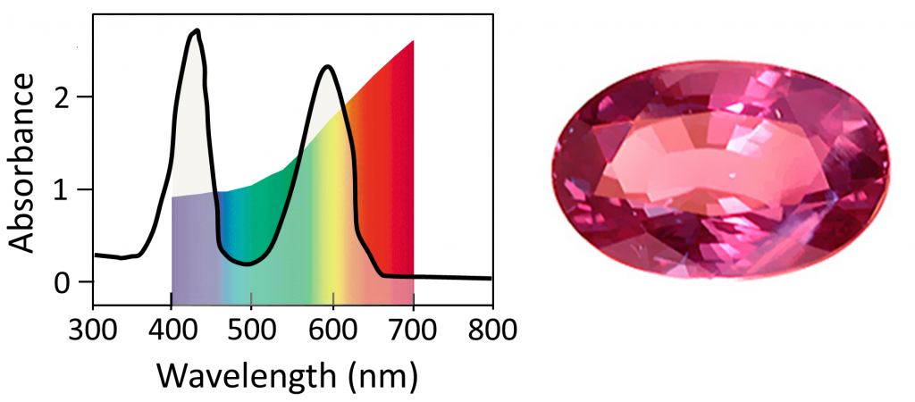
Colors of Metal Ions
Cr³⁺ doped
BeAl₂O₄
Uniform White Light
~400 nm = ⁴A_{2g} to ⁴T_{1g}
~600 nm = ⁴A_{2g} to ⁴T_{2g}
Sunlight
Candle Light
http://www.chemistry-blog.com/2013/08/22/alexandrite-effect-not-all-white-light-is-created-equal/

Slide 18
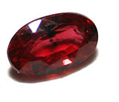
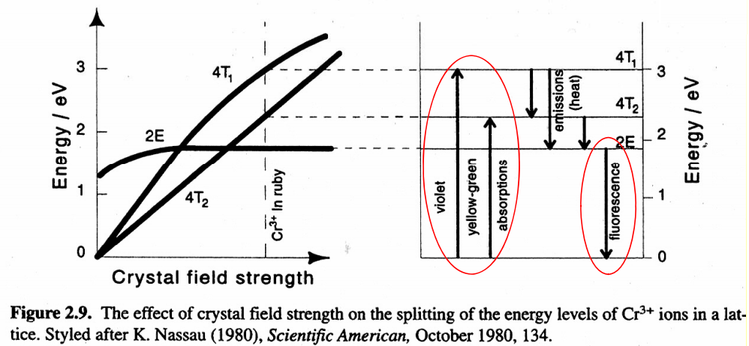
Colors of Metal Ions
Ruby
~1% Cr³⁺ doped Al₂O₃
Absorbs yellow-green region
Emits red
Most expensive ruby (1.6 cm³) = $6.7 million
Al₂O₃ (1.5 cm³) = ~$500

Slide 19
Absorption Spectra of Metal Ions
Intensity
Energy

Slide 20
Electronic Transitions
A = ε c l
ε
A = absorbance (unitless, A = log₁₀ P₀/P)
ε = molar absorptivity (L mol⁻¹ cm⁻¹)
l = path length of the sample (cm)
c = concentration (mol/L or M)
100
200
300
400
500
Wavelength (nm)
Transition probability –the probability of a particular transition taking place.
Depends on:
Energy of the transition/incident light.
Orientation of the molecule/material.
Symmetry of the initial and final states.
Angular momentum (spin).

Slide 21
States vs. Orbitals
S₂
S₁
Second Excited State (S₂)
Energy
First Excited State (S₁)
S₀
Single Orbital
Sum of Orbitals
and electron occupations
Ground
State (S₀)

Slide 22


Transition Moment
The transition probability of one molecule from one state (Ψ₁) to another state (Ψ₁) is given by |M⃗₂₁|, the transition dipole moment, or transition moment, from Ψ₁ to Ψ₂.
Transition moment:
S₂
S₁
Ψ₂
Energy
S₀
Ψ₁
where μ⃗ is the electric dipole moment operator:
where Q_{n} is charge, x⃗ n is the position vector operator.
For an electronic transition to be allowed, the transition moment integral must be nonzero.

Slide 23
Transition Moment
ε ≈
ε
100
200
300
400
500
Wavelength (nm)
x
Ψ₁
Ψ₂
hν
hν

Slide 24
Transition Moment
ε ≈
ε
100
200
300
400
500
Wavelength (nm)
If M⃗₂₁ = 0, then the transition probability is 0 and the transition from Ψ₁ to Ψ₂ is “forbidden” or electric-dipole “forbidden.”
If M⃗₂₁ ≠ 0, then the transition probability is not 0 and the transition from Ψ₁ to Ψ₂ is not “forbidden.”
M⃗₂₁ = 0, ε = 0
M⃗₂₁ ≠ 0, ε ≥ 0
Does not tell you definitively that it is allowed or how intense it will be. Only that it is not electric-dipole forbidden.

Slide 25



Transition Moment
Ψ₁
Ψ₂
allowedness of a transition
=
Irr. Rep. for the excited state
Irr. Rep. for the
linear basis
(x, y, and z)
Irr. Rep. for the ground state
hν
If the direct product DOES NOT contain the totally symmetric representation (A, A1, A1g…), then the transition is FORBIDDEN by symmetry arguments.
If the direct product DOES contain the totally symmetric representation (A, A1, A1g…), then the transition is ALLOWED by symmetry arguments.
The integral will be exactly zero if the Irr. Rep. of the direct product does not contain A, A₁, A_{g} , A_{1g} or A’.

Slide 26
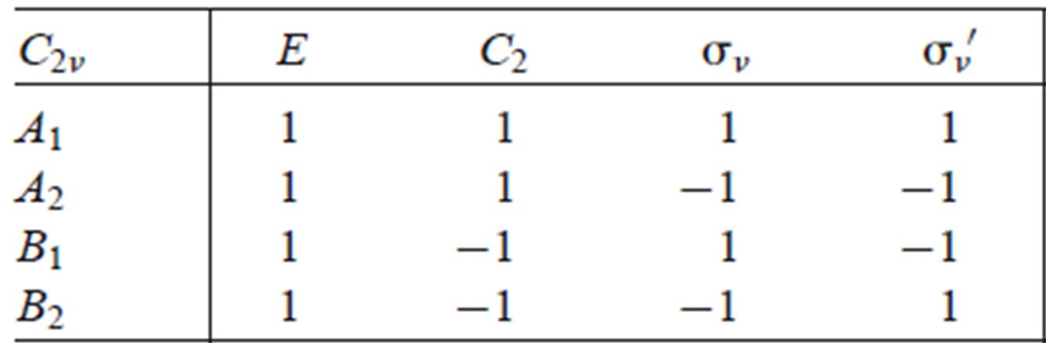




Direct Product
Direct product: The representation of the product of two representations is given by the product of the characters of the two representations.

Slide 27
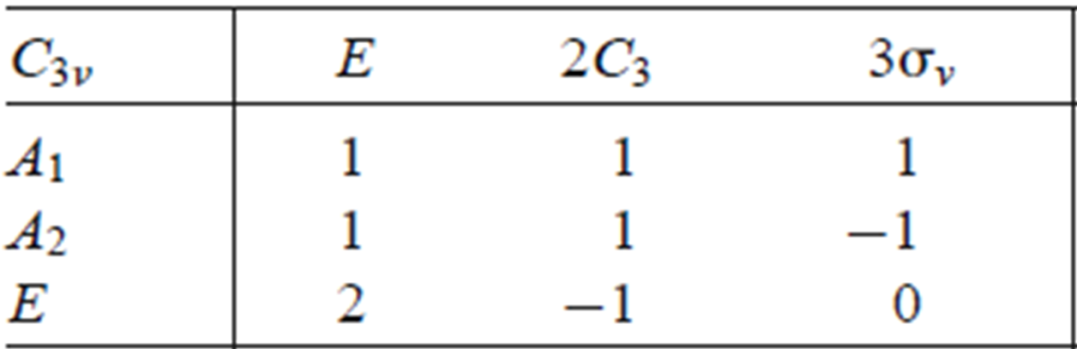

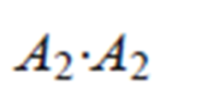





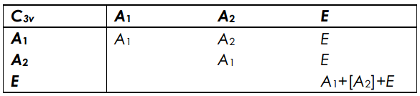
Direct Product Table

Slide 28
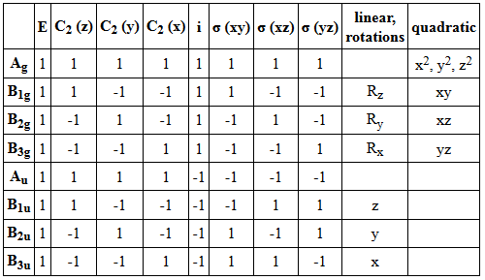
Example (d_{z2} to p_{z})
allowedness of a transition
=
Irr. Rep. for the excited state
Irr. Rep. for the ground state
Irr. Rep. for the
linear basis
(x, y, and z)
(z)
(x)
(y)
p
(pz)
D_{2h}
B_{1u}
B_{3u}
B_{2u}
B_{1u}
B_{1u}
hν
s
A_{g}
(z²)
(xy)
(xz)
(yz)
(x²-y²)
d
(dz²)
A_{g}
B_{1g}
B_{2g}
B_{3g}
A_{g}
A_{g}
A_{g}

Slide 29

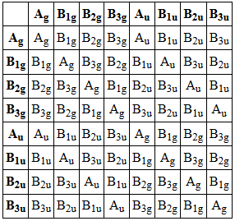
Example (d_{z2} to p_{z})
Irr. Rep. for the excited state
Irr. Rep. for the
linear basis
(x, y, and z)
Irr. Rep. for the ground state
=
allowedness of a transition
(p_{z})
B_{1u}
B_{1u}
A_{g}
=
B_{2g}
x basis
B_{1u}
B_{3u}
hν
y basis
B_{1u}
B_{2u}
A_{g}
=
B_{3g}
(dz²)
A_{g}
A_{g}
z basis
B_{1u}
B_{1u}
A_{g}
=
A_{g}
D_{2h}

Slide 30
Example (d_{z2} to p_{z})
Forbidden
(p_{z})
x basis
B_{1u}
B_{3u}
A_{g}
=
B_{2g}
B_{1u}
B_{1u}
Forbidden
y basis
B_{1u}
B_{2u}
A_{g}
=
B_{3g}
hν
Allowed
z basis
B_{1u}
B_{1u}
A_{g}
=
A_{g}
(d_{z2})
A_{g}
A_{g}
The transition is forbidden if the direct product does not contain A, A₁, A_{g} , A_{1g} or A’.
The transition is allowed if the direct product does contains A, A₁, A_{g} , A_{1g} or A’.
z polarized = allowed
hν
x polarized = forbidden
hν
d_{z2}
p_{z}
y polarized = forbidden
Allowed

Slide 31
Example (d_{xy} to p_{z})
allowedness of a transition
=
Irr. Rep. for the excited state
Irr. Rep. for the ground state
Irr. Rep. for the
linear basis
(x, y, and z)
(z)
(x)
(y)
p
(p_{z})
D_{2h}
B_{1u}
B_{3u}
B_{2u}
B_{1u}
B_{1u}
hν
s
A_{g}
(z²)
(xy)
(xz)
(yz)
(x²-y²)
d
(d_{xy})
A_{g}
B_{1g}
B_{2g}
B_{3g}
A_{g}
B_{1g}
B_{1g}

Slide 32
Example (d_{xy} to p_{z})
Irr. Rep. for the excited state
Irr. Rep. for the
linear basis
(x, y, and z)
Irr. Rep. for the ground state
=
allowedness of a transition
(p_{z})
B_{1u}
B_{1u}
B_{1g}
=
B_{3g}
x basis
B_{1u}
B_{3u}
hν
y basis
B_{1u}
B_{2u}
B_{1g}
=
B_{2g}
(d_{xy})
B_{1g}
B_{1g}
z basis
B_{1u}
B_{1u}
B_{1g}
=
B_{1g}
D_{2h}

Slide 33
Example (d_{xy} to p_{z})
Forbidden
(p_{z})
x basis
B_{1u}
B_{3u}
B_{1g}
=
B_{3g}
B_{1u}
B_{1u}
Forbidden
y basis
B_{1u}
B_{2u}
B_{1g}
=
B_{2g}
hν
Forbidden
z basis
B_{1u}
B_{1u}
B_{1g}
=
B_{1g}
(d_{xy})
B_{1g}
B_{1g}
The transition is forbidden if the direct product does not contain A, A₁, A_{g} , A_{1g} or A’.
The transition is allowed if the direct product does contains A, A₁, A_{g} , A_{1g} or A’.
z polarized = forbidden
hν
x polarized = forbidden
hν
d_{xy}
p_{z}
y polarized = forbidden
Forbidden

Slide 34

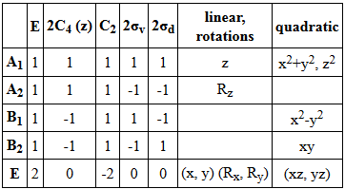
Example (d_{x2-y2} or d_{xy,yz} to p_{x,y})
allowedness of a transition
=
Irr. Rep. for the excited state
Irr. Rep. for the ground state
Irr. Rep. for the
linear basis
(x, y, and z)
d_{x2-y2} to p_{x,y}
(p_{x,y})
(z)
(x)
(y)
E
E
hν
C_{4v}
p
A₁
E
(d_{x2-y2})
B₁
B₁
s
d_{x2-y2} to p_{x,y}
A₁
(p_{x,y})
E
E
(z²)
(xy)
(xz)
(yz)
(x²-y²)
hν
d
A₁
B₂
E
B₁
(d_{xz,yz})
E
E

Slide 35
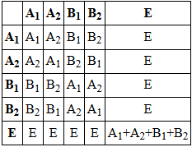
Example (d_{x2-y2} or d_{xy,yz} to p_{x,y})
d_{x2-y2} to p_{x,y}
(p_{x,y})
E
E
hν
Forbidden (z)
A₁
E
(d_{x2-y2})
E
B₁
=
B₁
B₁
E
A₁ + A₂ + B₁ + B₂
Allowed (x,y)
d_{x2-y2} to p_{x,y}
Allowed (z)
(p_{x,y})
A₁
A₁ + A₂ + B₁ + B₂
E
E
E
E
=
hν
E
E
Forbidden (x,y)
(d_{xz,yz})
A₁ + A₂ + B₁ + B₂
E
E
C_{4v}

Slide 36
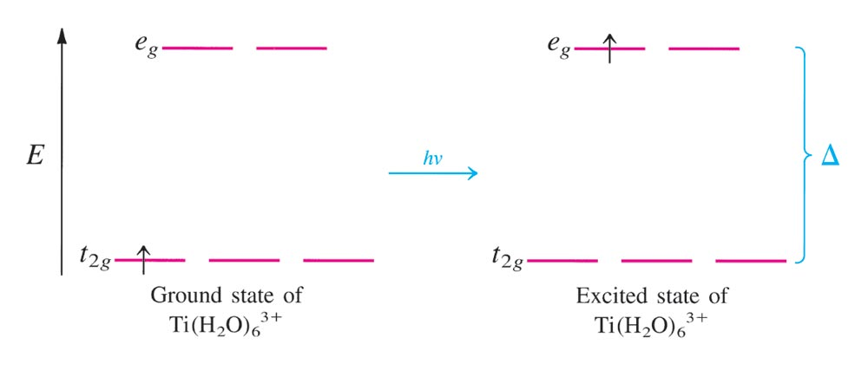
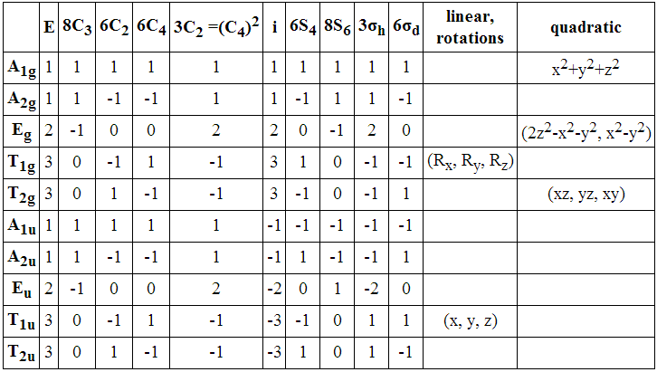
One Electron Octahedral
T_{2g}
E_{g}
E_{g}
T_{1u}
T_{2g}
=

Slide 37
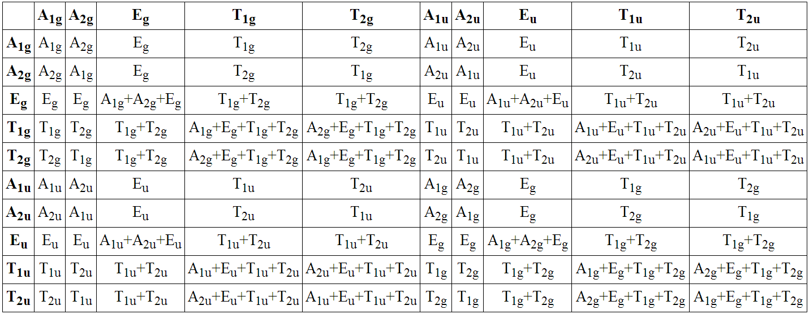
One Electron Octahedral
E_{g}
T_{1u}
T_{2g}
E_{g}
A_{2u} + E_{u} + T_{1u} + T_{2u}
Forbidden (x, y, z)
E_{u} + A_{1u} + A_{2u} + E_{u} + T_{1u} + T_{2u} + T_{1u} + T_{2u}

Slide 38
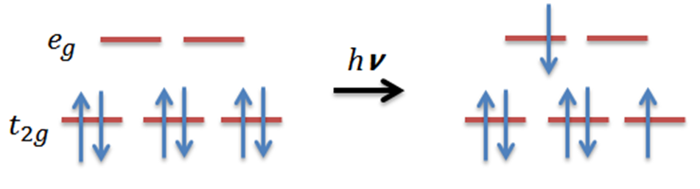
Six Electron Octahedral (Low spin)
Ground State
Excited State
A_{1g}
T_{2g}
E_{g}
T_{1g} + T_{2g}

Slide 39
Six Electron Octahedral (Low spin)
Ground State
Excited State
A_{1g}
T_{2g}
E_{g}
T_{1g} + T_{2g}
T_{1g}
T_{1u}
A_{1g}
=
T_{2g}

Slide 40
Six Electron Octahedral (Low spin)
Ground State
Excited State
A_{1g}
T_{2g}
E_{g}
T_{1g} + T_{2g}
T_{1g}
T_{1u}
A_{1g}
=
T_{2g}
A_{1u} + E_{u} + T_{1u} + T_{2u}
Forbidden (x, y, z)
A_{2u} + E_{u} + T_{1u} + T_{2u}

Slide 41
Simple Cases
1 electron (two states)
E_{g}
T_{1u}
T_{2g}
5 electron (two states)
T_{1g}
T_{1u}
A_{1g}
T_{2g}

Slide 42
More Complex Case (O_{h} d³)
Excited States
E_{g}
Ground State
T_{2g}

Slide 43
More Complex Case (O_{h} d², d³, d², d⁸)
There has to be an easier way to describe transitions between states!

Slide 44
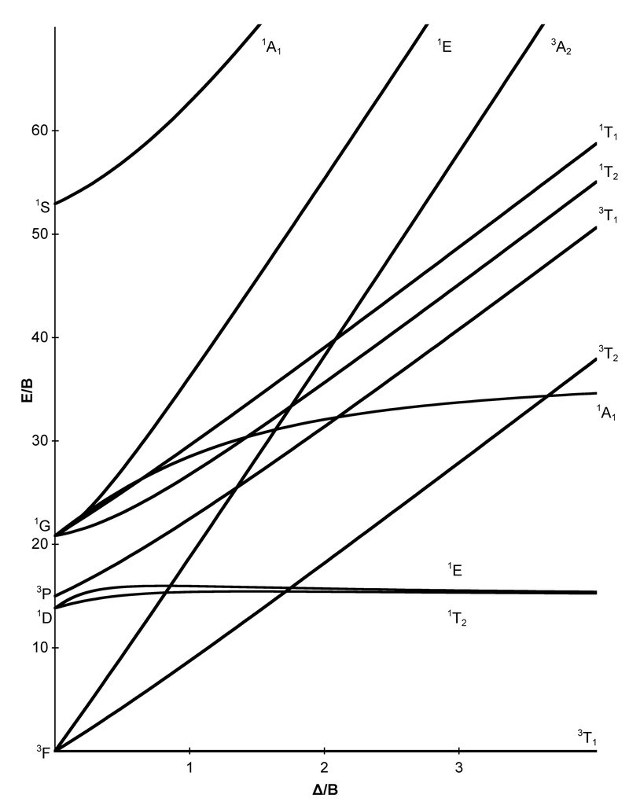
Tanabe-Sugano Diagrams
d³
Useful for:
Electronic States
Relative Energies
Ligand Field Affects
Optical Transitions
Spin Multiplicities
High-Spin to Low-Spin Transitions
Estimate Δ_{o}

Slide 45
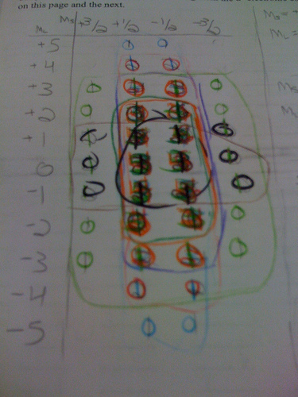
Getting to Tanabe-Sugano Diagrams
Electronic States
Term symbols
Microstate tables
Correlation diagrams
Tanabe-Sugano diagrams
Selection rules

Slide 46
Quantum Numbers
PRINCIPAL (n): energy level, the distance the orbital is from the nucleus
n = 1, 2, 3, 4…
ANGULAR MOMENTUM: l, shape of the orbital
s = 0, p = 1, d = 2, f = 3
MAGNETIC: m_{l ,} spatial orientation
m_{l} = 0 for s; -1, 0, +1 for p; -2, -1, 0, +1, +2 for d, etc.
SPIN: m_{s} spin
m_{s} = +1/2 or -1/2)

Slide 47
Quantum Numbers
F atom
1s
2s
2p
The third electron is in the 2s orbital.
n =
2
0
0
+1/2
l =
m_{l} =
m_{s}=
The eighth electron is in a 2p orbital.
n =
2
1
-1
-1/2
l =
m_{l} =
m_{s}=
Only describes single electron states!
What about multielectron states?

Slide 48
Many Electron States
Many electron interactions are described by
Russel-Saunders or L-S coupling scheme
M_{L} = total orbital angular momentum =Σm_{l}
M_{S} = total spin angular momentum = Σm_{s}
Summarized by term symbols that contain:
- spin multiplicity (2S+1)
- angular momentum quantum number (L)
- the total angular momentum (J )
^{2S+1}L_{J}
The interactions produce atomic states called microstates.

Slide 49
Term Symbols
S represents the total spin angular momentum
S = total spin angular momentum = Σm_{s}
+1/2
S = 1/2
²L_{J}
^{2S+1}L_{J}
+1/2
+1/2
-1/2
+1/2
S = 1
³L_{J}
L specifies the total orbital angular momentum
L = angular momentum = Σm_{l}
L = 3
³F_{J}
For D orbitals
L = 2
m_{l} =
+2
+1
0
-1
-2
L = 0
³S_{J}
m_{l} =
+2
+1
0
-1
-2
J = Total angular momentum
J = L+S, L+S-1, L+S-2,….|L-S|
Spin Orbit Coupling
L = | 0 | 1 | 2 | 3 | 4
Term Symbol | S | P | D | F | G

Slide 50
Term Symbols

Slide 51
Term Symbols
We are only assigning one state at a time!
To assign all the states we turn to a microstate table!

Slide 52
Microstate Table
A microstate table contains all possible combinations of m_{l} and m_{s}.
Each microstate represents a possible electron configuration.
It includes both ground and excited states.
Must obey the Pauli Exclusion Principle.
p²
total spin angular momentum
M_{L} | +1 | 0 | -1
+2: |  | 1⁺1⁻
+1: | 1⁺0⁺ | 1⁺0⁻ 1⁻0⁺ | 1⁻0⁻
0: | -1⁺1⁺ | -1⁺1⁻ 0⁺0⁻ -1⁻1⁺ | -1⁻1⁻
-1: | -1⁺0⁺ | -1⁺0⁻ -1⁻0⁺ | -1⁻0⁻
-2: |  | -1⁺-1⁻
total orbital
angular momentum

Slide 53
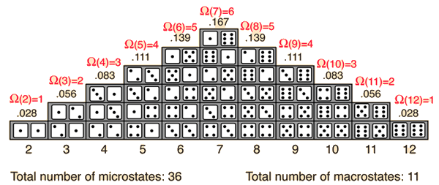
Microstates
M_{L} | +1 | 0 | -1
+2: |  | 1⁺1⁻
+1: | 1⁺0⁺ | 1⁺0⁻ 1⁻0⁺ | 1⁻0⁻
0: | -1⁺1⁺ | -1⁺1⁻ 0⁺0⁻ -1⁻1⁺ | -1⁻1⁻
-1: | -1⁺0⁺ | -1⁺0⁻ -1⁻0⁺ | -1⁻0⁻
-2: |  | -1⁺-1⁻

Slide 54
Microstate Table Notation
p² electron configuration
Two electrons in p_{x}, p_{y} and p_{z} orbitals.
e⁻ spin
m_{l} = +1 0 -1 microstate:
Ground State ___ ___ ___ (1⁺,0⁺)
Configurations: ___ ___ ___ (0⁺,-1⁺)
___ ___ ___ (1⁺,-1⁺)
e⁻ m_{l}
m_{l} = +1 0 -1 microstate:
A few Excited State ___ ___ ___ (1⁺,1⁻)
Configurations: ___ ___ ___ (0⁺,0⁻)
___ ___ ___ (-1⁺,-1⁻)

Slide 55
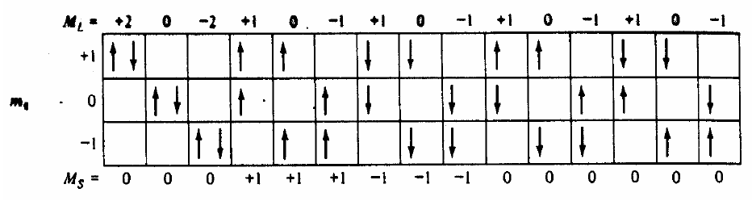
Microstate Table Notation
(1⁺,1⁻)
(-1⁺,-1⁻)
(1⁺,-1⁺)
(1⁻,0⁻)
(0⁻,-1⁻)
(1⁺,-1⁻)
(1⁻,0⁺)
(0⁻,-1⁺)
(0⁺,0⁻)
(1⁺,0⁺)
(0⁺,-1⁺)
(1⁻,-1⁻)
(1⁺,0⁻)
(0⁺,-1⁻)
(1⁻,-1⁺)
15 total possible states

Slide 56
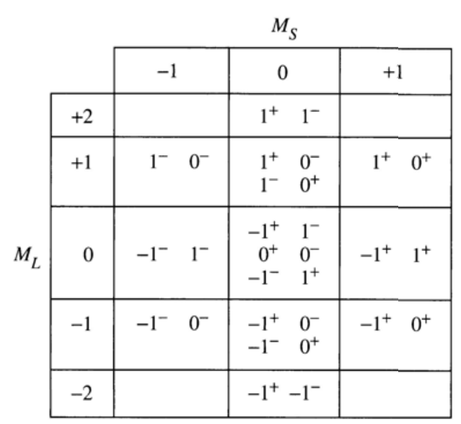
Microstate Table
15 total possible states
(1⁺,1⁻)
(-1⁺,-1⁻)
(1⁺,-1⁺)
(1⁻,0⁻)
(0⁻,-1⁻)
(1⁺,-1⁻)
(1⁻,0⁺)
(0⁻,-1⁺)
(0⁺,0⁻)
(1⁺,0⁺)
(0⁺,-1⁺)
(1⁻,-1⁻)
(1⁺,0⁻)
(0⁺,-1⁻)
(1⁻,-1⁺)
total spin angular momentum
total orbital
angular momentum

Slide 57
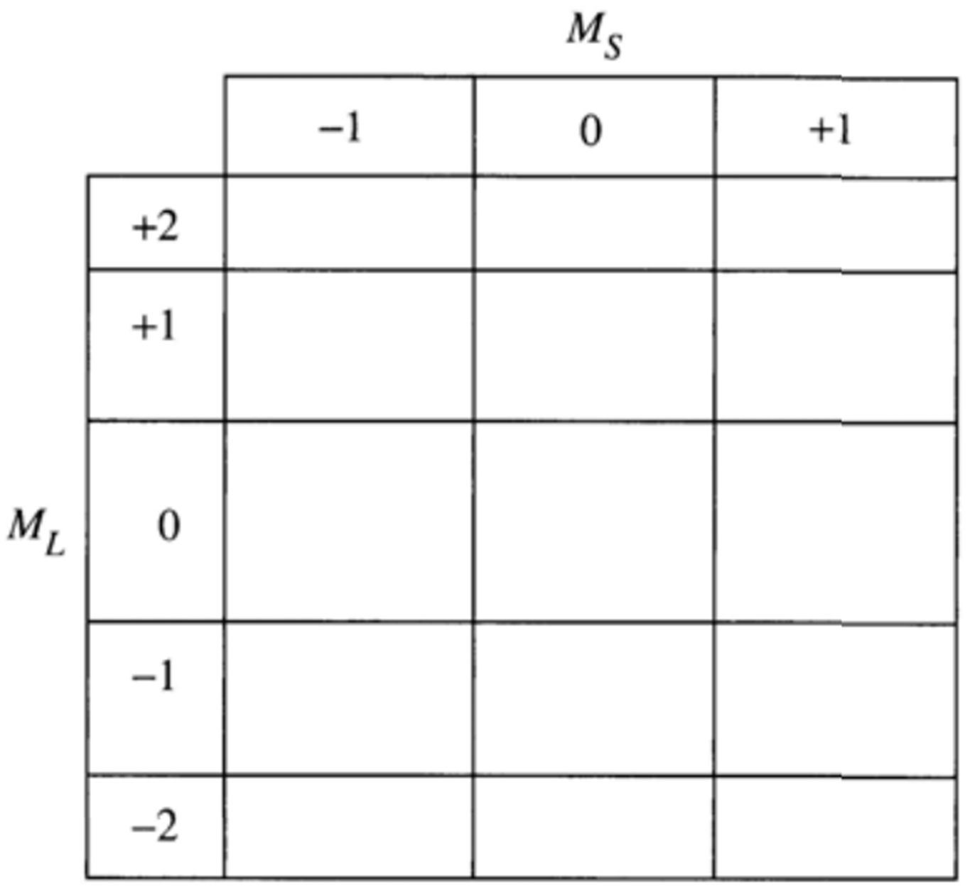
Microstate Table
15 total possible states
X
X
X
X
X
X
X
X
X
X
X
X
X
X
X
Group Energetically equivalent states.

Slide 58
Microstate Table
15 total possible states
X
X
X
X
X
X
X
X
X
X
X
X
X
X
X
Group Energetically equivalent states.

Slide 59
Microstate Table
15 total possible states
X
X
X
X
X
X
X
X
X
X
X
X
X
X
X
Group Energetically equivalent states.

Slide 60
Microstate Table
15 total possible states
X
X
X
X
X
X
X
X
X
X
X
X
X
X
X
Group Energetically equivalent states.

Slide 61
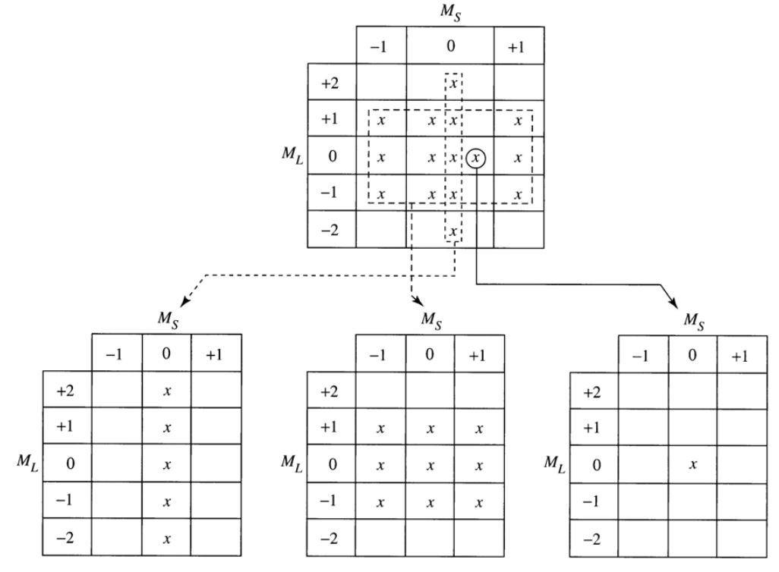
Term Symbol from Microstate Tables
^{2S+1}L
S = highest M_{s}
L = highest M_{l}
¹D
³P
¹S
5 equivalent states
9 equivalent states
1 state

Slide 62
Relative Energies
¹D
³P
¹S
5 E equivalent states
9 E equivalent states
1 state
For a given electron configuration, the term with the greatest multiplicity lies lowest in energy. (Hund’s rule.)
For a term of a given multiplicity, the greater the value of L, the lower the energy.
Lowest E
Highest E
³P
<
¹D
<
¹S
Note: The rules for predicting the ground state always work, but they may fail in predicting the order of energies for excited states.

Slide 63
Microstate Table Notation
d² electron configuration
Two electrons in d_{xy}, d_{xz}, d_{xy}, d_{z2} and d_{x2-y2} orbitals.
m_{l} = +2 +1 0 -1 -2 microstate
___ ___ ___ ___ ___ (2⁺, 1⁺)
___ ___ ___ ___ ___ (1⁺, 0⁺)
Configurations: ___ ___ ___ ___ ___ (2⁺, 2⁻)
___ ___ ___ ___ ___ (1⁺, -2⁻)
___ ___ ___ ___ ___ (2⁺, -1⁺)
etc.
45 microstates (M_{L} = 4→-4, and M_{S}=1, 0 or -1)

Slide 64
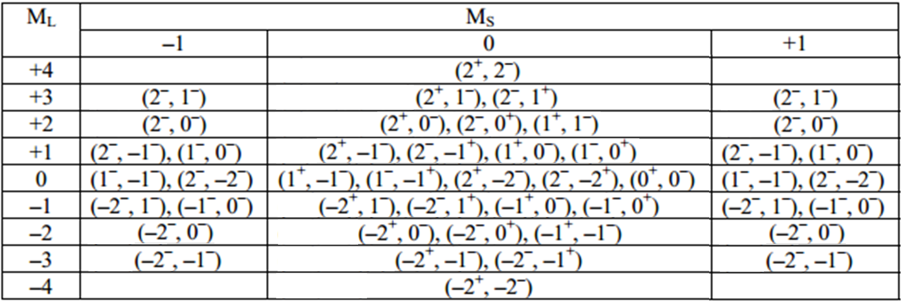
Microstate Table Notation
d² electron configuration
Two electrons in d_{xy}, d_{xz}, d_{xy}, d_{z2} and d_{x2-y2} orbitals.

Slide 65
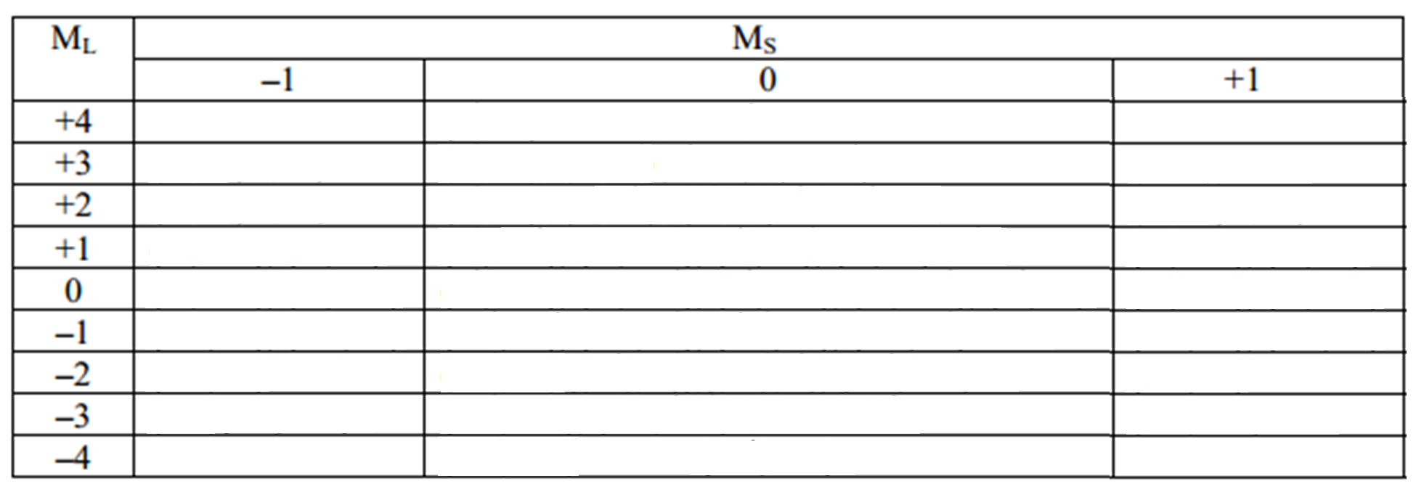
Microstate Table Notation
d² electron configuration
Two electrons in d_{xy}, d_{xz}, d_{xy}, d_{z2} and d_{x2-y2} orbitals.
X
X
X
X
X
X
X
X
X
X
X
X
X
X
X
X
X
X
X
X
X
X
X
X
X
X
X
X
X
X
X
X
X
X
X
X
X
X
X
X
X
X
X
X
X

Slide 66
Microstate Table Notation
d² electron configuration
Two electrons in d_{xy}, d_{xz}, d_{xy}, d_{z2} and d_{x2-y2} orbitals.
X
X
X
X
X
X
X
X
X
X
X
X
X
X
X
X
X
X
X
X
X
X
X
X
X
X
X
X
X
X
X
X
X
X
X
X
X
X
X
X
X
X
X
X
X
^{2S+1}L
S = highest M_{s}
L = highest M_{l}
¹G
L = | 0 | 1 | 2 | 3 | 4
Term Symbol | S | P | D | F | G

Slide 67
Microstate Table Notation
d² electron configuration
Two electrons in d_{xy}, d_{xz}, d_{xy}, d_{z2} and d_{x2-y2} orbitals.
X
X
X
X
X
X
X
X
X
X
X
X
X
X
X
X
X
X
X
X
X
X
X
X
X
X
X
X
X
X
X
X
X
X
X
X
X
X
X
X
X
X
X
X
X
^{2S+1}L
S = highest M_{s}
¹G
³F
L = highest M_{l}
L = | 0 | 1 | 2 | 3 | 4
Term Symbol | S | P | D | F | G

Slide 68
Microstate Table Notation
d² electron configuration
Two electrons in d_{xy}, d_{xz}, d_{xy}, d_{z2} and d_{x2-y2} orbitals.
X
X
X
X
X
X
X
X
X
X
X
X
X
X
X
X
X
X
X
X
X
X
X
X
X
X
X
X
X
X
X
X
X
X
X
X
X
X
X
X
X
X
X
X
X
^{2S+1}L
S = highest M_{s}
¹G
³F
¹D
L = highest M_{l}
L = | 0 | 1 | 2 | 3 | 4
Term Symbol | S | P | D | F | G

Slide 69
Microstate Table Notation
d² electron configuration
Two electrons in d_{xy}, d_{xz}, d_{xy}, d_{z2} and d_{x2-y2} orbitals.
X
X
X
X
X
X
X
X
X
X
X
X
X
X
X
X
X
X
X
X
X
X
X
X
X
X
X
X
X
X
X
X
X
X
X
X
X
X
X
X
X
X
X
X
X
^{2S+1}L
S = highest M_{s}
¹G
³F
¹D
³P
L = highest M_{l}
L = | 0 | 1 | 2 | 3 | 4
Term Symbol | S | P | D | F | G

Slide 70
Microstate Table Notation
d² electron configuration
Two electrons in d_{xy}, d_{xz}, d_{xy}, d_{z2} and d_{x2-y2} orbitals.
X
X
X
X
X
X
X
X
X
X
X
X
X
X
X
X
X
X
X
X
X
X
X
X
X
X
X
X
X
X
X
X
X
X
X
X
X
X
X
X
X
X
X
X
X
^{2S+1}L
S = highest M_{s}
¹G
³F
¹D
³P
¹S
L = highest M_{l}
L = | 0 | 1 | 2 | 3 | 4
Term Symbol | S | P | D | F | G

Slide 71
Microstate Table Notation
d² electron configuration
Two electrons in d_{xy}, d_{xz}, d_{xy}, d_{z2} and d_{x2-y2} orbitals.
¹G
³F
¹D
³P
¹S
For a given electron configuration, the term with the greatest multiplicity lies lowest in energy. (Hund’s rule.)
For a term of a given multiplicity, the greater the value of L, the lower the energy.
Lowest E
Highest E
³F
<
³P
<
¹G
<
¹D
<
¹S
Note: The rules for predicting the ground state always work, but they may fail in predicting the order of energies for excited states.
Lowest E
Highest E
Real Order
³F
<
¹D
<
³P
<
¹G
<
¹S

Slide 72
Microstate Table
d³ electron configuration
Three electrons in d_{xy}, d_{xz}, d_{xy}, d_{z2} and d_{x2-y2} orbitals.
m_{l} = +2 +1 0 -1 -2 microstate
___ ___ ___ ___ ___ (2⁺,2⁻,1⁺)

Slide 73
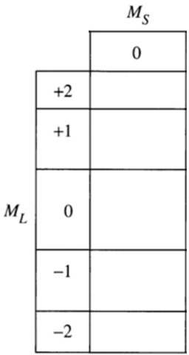
Microstate Table Notation
d¹ electron configuration
Two electrons in d_{xy}, d_{xz}, d_{xy}, d_{z2} and d_{x2-y2} orbitals.
m_{l} = +2 +1 0 -1 -2 microstate
___ ___ ___ ___ ___ (2⁺)
___ ___ ___ ___ ___ (1⁺)
Configurations: ___ ___ ___ ___ ___ (0⁺)
___ ___ ___ ___ ___ (-1⁺)
___ ___ ___ ___ ___ (-2⁺)
(2⁺)
(1⁺)
(0⁺)
(0⁺)
(0⁺)
^{2S+1}L
²D
S = highest M_{s}
L = highest M_{l}

Slide 74
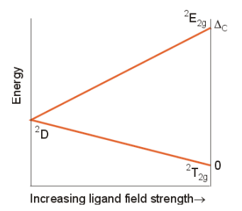
Ligand Field Dependence
One d electron (d¹)
d_{xy}, d_{xz}, d_{xy}, d_{z2} and d_{x2-y2}
___ ___
___ ___ ___
___ ___
___ ___ ___
___ ___ ___ ___ ___
___ ___ ___ ___ ___
___ ___ ___ ___ ___
___ ___ ___ ___ ___
___ ___ ___ ___ ___
²D
e_{g}
___ ___
___ ___ ___
t_{2g}
___ ___
___ ___ ___
___ ___
___ ___ ___
Degenerate
symmetric field
Infinite
O_{h} field
Real molecules
Absence of ligand field.
Free-ion term.
All d orbitals are E equal.
Correlation Diagram
Orgel Diagram
Strong ligand field.
Coord Complex.
d orbitals not degenerate
d_{z2} and d_{x2-y2} higher E
d_{xy}, d_{xz} and d_{yz} lower E

Slide 75
Correlation Diagram
d¹ Term symbols
d² Term symbols
=
²D
= ³F, ¹D, ³P, ¹G, ¹S

Slide 76
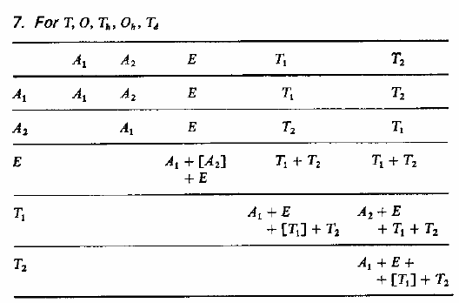
Correlation Diagram
___ ___
___ ___ ___
___ ___
___ ___ ___
Term # of States Terms in O_{h} Field
S 1 A_{1g}
P 3 T_{1g}
D 5 T_{2g} + E_{g}
F 7 T_{1g} + T_{2g} + A_{2g}
G 9 A_{1g} + E_{g}+T_{1g}+T_{2g}
___ ___
___ ___ ___
___ ___
___ ___ ___
___ ___
___ ___ ___
___ ___
___ ___ ___

Slide 77
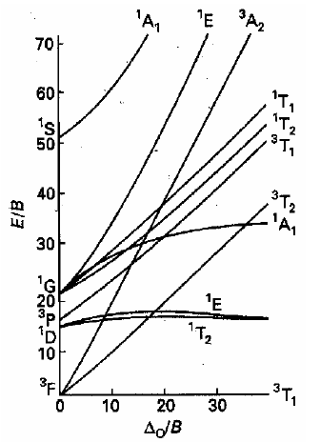
Correlation vs. Tanabe-Sugano Diagrams
Correlation Diagram
Tanabe-Sugano Diagram
d²
Number of states.
General sense of field effects. Only qualitative.
Number of states.
Field effects.
Quantitative.

Slide 78
Tanabe-Sugano Diagrams
d²
Relative energies.
Ligand field affects.
Electronic states with the same symmetry can not cross (non-crossing rule).
Curvature (¹E and ¹E).
Ground state on the x-axis.
Transitions between states.
Energy
Ligand Field

Slide 79
Tanabe-Sugano Diagrams
d²
10 possible transitions
Excited States
Not all transition probabilities are equal!
Energy
Ground State
Ligand Field

Slide 80
Selection Rules
Selection rules determine the probability (intensity) of the transition.
Symmetry (Laporte) Selection Rule: The initial and final wavefunctions must change in parity. Parity is related to the orbital angular momentum summation over all elections Σl_{i}, which can be even or odd; only even ↔ odd transitions are allowed. Transitions between the orbitals of the same sub shell are forbidden.
Spin Selection Rule: There must be no change in the spin multiplicity (ΔS = 0) during the transition.
i.e. the spin of the electron must not change during the transition.

Slide 81

Selection Rules
Selection rules determine the probability (intensity) of the transition.
Symmetry (Laporte) Selection Rule: The initial and final wavefunctions must change in parity. Only even (g) ↔ odd (u) transitions are allowed. Transitions between the orbitals of the same sub shell are forbidden.
g→g u→u g→u u→g
Forbidden
Allowed
For O_{h} complexes
allowedness of a transition
= T_{1u}
=
Forbidden
u =
g
u
g
Direct Product Rules
Forbidden
u =
u
u
u
g
u
= u
g
g
g
= g
Allowed
g =
u
u
u
u
= g
Allowed
g =
u
u
g

Slide 82
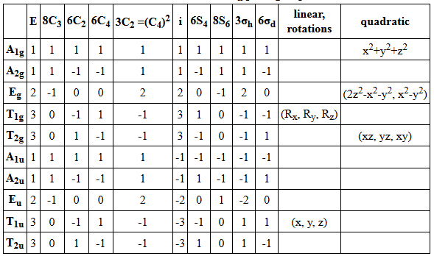
Selection Rules
Selection rules determine the probability (intensity) of the transition.
Symmetry (Laporte) Selection Rule: The initial and final wavefunctions must change in parity. Only even (g) ↔ odd (u) transitions are allowed. Transitions between the orbitals of the same sub shell are forbidden.
g→g u→u g→u u→g
Forbidden
Allowed
For O_{h} complexes
d → d
Forbidden
t_{2g} → e_{g}
d → p
Allowed
t_{2g} → t_{1u}
p → p
Forbidden
t_{1u} → t_{1u}

Slide 83
Selection Rules
Selection rules determine the probability (intensity) of the transition.
Symmetry (Laporte) Selection Rule: The initial and final wavefunctions must change in parity. Parity is related to the orbital angular momentum summation over all elections Σl_{i}, which can be even or odd; only even ↔ odd transitions are allowed. Transitions between the orbitals of the same sub shell are forbidden.
Spin Selection Rule: There must be no change in the spin multiplicity (ΔS = 0) during the transition.
i.e. the spin of the electron must not change during the transition.

Slide 84

Selection Rules
Selection rules determine the probability (intensity) of the transition.
Spin Selection Rule: There must be no change in the spin multiplicity (ΔS = 0) during the transition. i.e. the spin of the electron must not change during the transition.
hν
hν
¹L
¹L*
¹L
³L*
Allowed
Forbidden
¹T₁ → ¹T₂
Allowed
Conservation of angular momentum.
¹T₁ → ³T₁
Forbidden
³T₁ → ¹A₂
Forbidden

Slide 85
Tanabe-Sugano Diagrams
Complete Diagram
Spin Only Diagram
d²

Slide 86
Selection Rules
Selection rules determine the probability (intensity) of the transition.
Symmetry (Laporte) Selection Rule: The initial and final wavefunctions must change in parity.
Spin Selection Rule: The spin of the electron must not change during the transition.
Transition ε_{max} (M⁻¹cm⁻¹)
Spin and Symmetry forbidden "d-d" bands 0.02 - 1
Spin allowed and Symmetry forbidden "d-d" bands 1 - 10
Spin and Symmetry allowed CT bands 10³ - 5 x 10⁴

Slide 87

Tanabe-Sugano Diagrams
All d-d transitions are symmetry (Laporte) “forbidden”
d²
Spin-allowed transitions
³T_{1g} → ³T_{2g}
³T_{1g} → ³T_{1g}
Energy
³T_{1g} → ³A_{2g}
Ligand Field

Slide 88





d¹ and d⁹ Tanabe-Sugano Diagram
d¹
d⁹
[Ti(H₂O)₆]³⁺

Slide 89


d³ Tanabe-Sugano Diagram
d³
Ruby
~1% Cr³⁺ doped Al₂O₃

Slide 90

d³ Tanabe-Sugano Diagram
d⁸

Slide 91

d⁶ Tanabe-Sugano Diagram
d⁶
High Spin
Low Spin
Energy
High Spin
Low Spin
⁵T_{2g}
¹A_{1g}
Ligand Field
Smaller Δ_{ο}
Larger Δ_{ο}
The Spectrochemical Series
I⁻ < Br⁻ < Cl⁻ < OH⁻ < RCO₂⁻ < F⁻ < H₂O < NCS⁻ < NH₃ < en < NO₂⁻ < phen < CO, CN⁻

Slide 92


Tanabe-Sugano Diagram
d⁴
d⁵
d⁷

Slide 93

d⁶ Tanabe-Sugano Diagram
Complex Ion λ_{abs} (nm)
[Co(H₂O)₆] ³⁺ 600, 400
[Co(NH₃)₆] ³⁺ 475, 340
[Co(en)₃] ³⁺ 470, 340
Smaller Δ_{ο}
Larger Δ_{ο}
The Spectrochemical Series
I⁻ < Br⁻ < Cl⁻ < OH⁻ < RCO₂⁻ < F⁻ < H₂O < NCS⁻ < NH₃ < en < NO₂⁻ < phen < CO, CN⁻

Slide 94
Selection Rules
Selection rules determine the probability (intensity) of the transition.
Symmetry (Laporte) Selection Rule: The initial and final wavefunctions must change in parity.
Spin Selection Rule: The spin of the electron must not change during the transition.
Transition ε_{max} (M⁻¹cm⁻¹)
Spin and Symmetry forbidden "d-d" bands 0.02 - 1
Spin allowed and Symmetry forbidden "d-d" bands 1 - 10
Spin and Symmetry allowed CT bands 10³ - 5 x 10⁴
Why do we see “forbidden” transitions at all?

Slide 95
Allowing “Forbidden” Transitions
Mechanisms that make “forbidden” electronic transitions to be “allowed”
1) Vibronic Coupling: Electronic states coupled to vibrational states help overcome the Laporte selection rule.
2) Spin-orbit Coupling: Spin and orbital angular momenta can interact to make spin “forbidden” transitions allowed.j
3) Mixing of states: π-acceptor and π-donor ligands can mix with the d-orbitals transitions are no longer purely d-d.

Slide 96

Vibronic Coupling
Ground State
Excited State
O_{h} symmetry
A_{1g}
T_{1g} + T_{2g}
The transition probability of one molecule from one state (Ψ₁) to another state (Ψ₁) is given by |M⃗₂₁|, the transition dipole moment, or transition moment, from Ψ₁ to Ψ₂.
T_{1g}
T_{1u}
A_{1g}
=
T_{2g}
A_{1u} + E_{u} + T_{1u} + T_{2u}
A_{2u} + E_{u} + T_{1u} + T_{2u}
allowedness of a transition
=
Electronically Forbidden (x, y, z)

Slide 97


Vibronic Coupling
Ground State
Excited State
O_{h} symmetry
A_{1g}
T_{1g} + T_{2g}
For octahedral complex, there are 15 vibrational normal modes with irreducible representations:
Vibrational transition couple with electronic transition:

Slide 98




Vibronic Coupling
excited state
vibrational wavefunction
ground state
vibrational wavefunction

Slide 99



Vibronic Coupling
For O_{h}
Γ_{ev}
Γ_{gv}
T_{1g}
(A_{1g}, E_{g} , T_{1u} , T_{2g} , T_{2u})
T_{1u}
A_{1g}
A_{1g}
T_{2g}
T_{1u}and T_{2u} vibrations can couple with the electronic transition to form allowed transitions.

Slide 100
Vibronic Coupling
excited state
vibrational wavefunction
ground state
vibrational wavefunction
T_{1u}and T_{2u} vibrations can couple with the electronic transition to form the allowed vibronic transition.

Slide 101
Spin-Orbit Coupling
Lower Energy
Nicholas J. Turro, Principles of Molecular Photochemistry

Slide 102


Spin-Orbit Coupling
Spin Selection Rule: There must be no change in the spin multiplicity (ΔS = 0) during the transition. i.e. the spin of the electron must not change during the transition.
hν
hν
¹L*
¹L
³L*
Allowed
Forbidden
Spin-orbit Coupling
Conservation of angular momentum.

Slide 103


Spin-Orbit Coupling
Heavy Atoms
Pt, Ir, Os, I...
Ru(bpy)₃
Os(bpy)₃
Nicholas J. Turro, Principles of Molecular Photochemistry

Slide 104
Mixing of States
d²
Tunabe-Sugano diagram assumes pure d-d transitions
Mixing of states: π-acceptor and π-donor ligands can mix with the d-orbitals transitions are no longer purely d-d.
Energy
Ligand Field

Slide 105
Selection Rules
Selection rules determine the probability (intensity) of the transition.
Symmetry (Laporte) Selection Rule: The initial and final wavefunctions must change in parity.
Spin Selection Rule: The spin of the electron must not change during the transition.
Transition ε_{max} (M⁻¹cm⁻¹)
Spin and Symmetry forbidden "d-d" bands 0.02 - 1
Spin allowed and Symmetry forbidden "d-d" bands 1 - 10
Spin and Symmetry allowed CT bands 10³ - 5 x 10⁴

Slide 106
Outline
Absorption spectroscopy
Types of transitions
atomic
molecular
d-d transitions
Transition moment
Microstates
Correlation diagrams
Tanabe-Sugano diagrams
Selection rules

